Slide 1
Towards a system to aid communication with Deaf Submitted by Ah.Zia Yosufi & Mehreen Najm Under the Suprevision of Assist.Prof Rafiullah Momand Information systems Department Computer Science Faculty Kabul University

Slide 2
Outline
Introduction
Problem definition
Literature Review
Research Goals
Dataset gathering
Implementation
Train/Test system
Conclusion

Slide 3
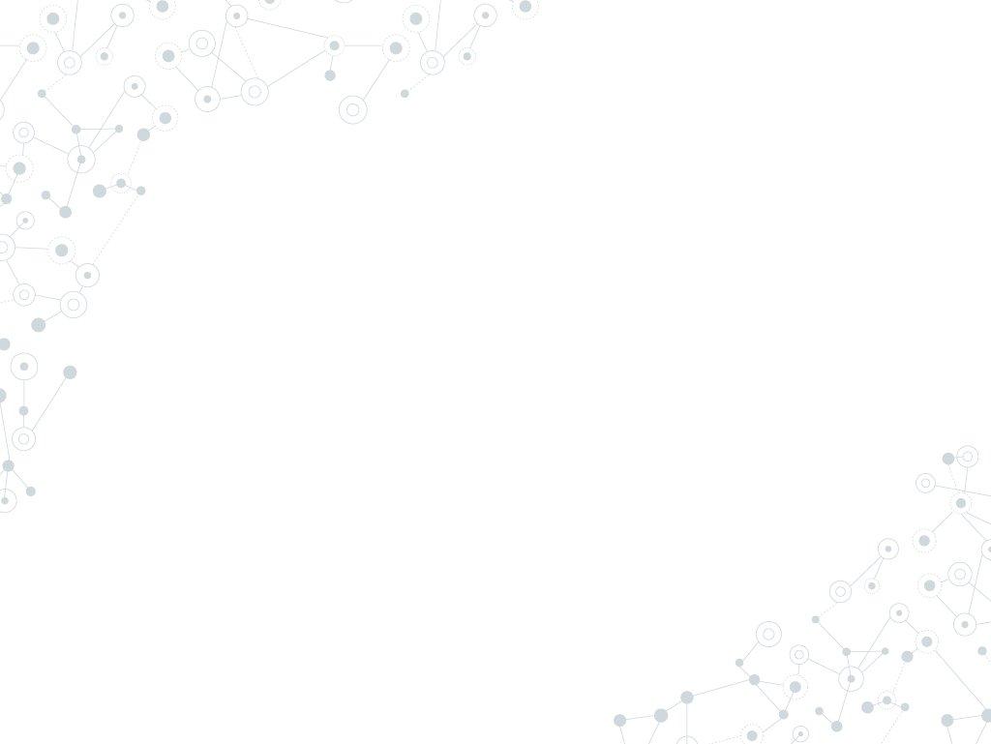
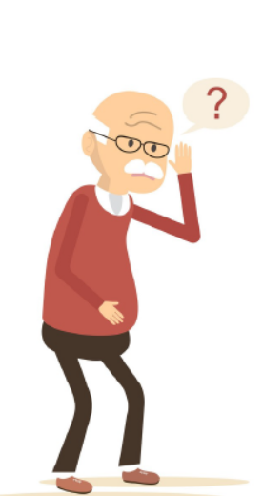
Introduction
Deaf are people who can’t talk and hear, hearing people are unfamiliar with Deaf because they don’t know their language. [1]
Sign language for deaf people has special features that are quite different from those of spoken language. Sign language is an iconic language compared to spoken language, which is more of an arbitrary one. Another crucial difference between the two languages is that sign language does not have its own writing system. Therefore, in order to write descriptions of signs, line drawings, photographs and illustrations have commonly been used, but these represent only a very small moment in the process of actual signing. [2]

Slide 4
1.
Problem Statement
In our modern information and communication society, daily life would be unimaginable without technology. Information and Communications Technology (ICT) is also very useful for people with special needs.
People think that if you cannot hear, you can easily access any necessary information by simply reading it in written form, and if you really need to communicate, you can always write your message down. [1]
But this system is not an efficient way to communicate, Deaf have their own language of communication (sign language), they can only understand this language and also they write and read Faster on sign writing.
According to survey in 2015, there are 121 “Deaf sign languages” in the world, but there is not such an efficient mechanism where Deaf can easily understand people thoughts. [3]

Slide 5
Litrature Review

Slide 6
Area 1: TESSA
TESSA is an experimental system that aims to aid transactions between a deaf person and a clerk in a Post Office. [4]

Slide 7
Area 2: HandTalk
Founded in 2012, Hand Talk performs digital and automatic translation into the Brazilian Sign Language.[5]

Slide 8
Area 3: Braille
This system includes a smart glove that translates the Braille alphabet, which is used almost universally by the literate deaf blind population, into text and vice versa. [6]

Slide 9
Area 4: Deaf-Mute Communication Interpreter
The glove is internally equipped with five flex sensors, tactile sensors and accelerometer. For each specific gesture, the flex sensor produces a proportional change in resistance and accelerometer measures the orientation of hand.[7]

Slide 10
Area 5: Arabic Sign Language Interpreter
Translates Arabic language to Arabic Sign Language. [8]

Slide 11
Area 6: Scribe4Me
When a user presses a button on her Scribe4Me PDA, the last 30 seconds of sound is uploaded, transcribed and sent back to her as a text message. [9]

Slide 12
Area 7: A Spanish speech to sign language translation system for assisting Deaf-Mute People
This system translates officer explanations into sign language for deaf-mute people. The translation system is composed by a speech recognizer (for decoding the spoken utterance into a word sequence), a natural language translator (for converting a word sequence into a sequence of gestures belonging to the sign language), and a 3D avatar animation module. [10]

Slide 13
Area 8: ATLAS
A system for the computer-assisted translation from Italian Language to LIS that provides the output of the translation resorting to a virtual avatar. [11]

Slide 14
Goals
This in turn requires the solution of the following problems:
Automatic speech to text conversion (speech Recognition).
Automatic translation of English text into a suitable representation of sign language using Machine Translation.
Display of this representation as a sequence of Signs using computer graphics techniques.
We will suggest an efficient mechanism/system that Deaf can easily communicate with ordinary people to understand their thoughts.
We are using International Sign language that later any sign language can be embedded with it.
We are using SignWritingOneD.

Slide 15
Dataset Gathering
The dataset used is a sample of common words and sentences that deaf are using daily.
We have searched many sources for gathering dataset such as Wikipedia pages, some books like (Goldilocks & the Three Bears in American Sign Language, The Book of Jonah) , Signbank and other sources
the dataset that was used for this project is a subset of a much larger dataset, as described in http://www.signbank.org/signbank.html
This source includes around 10000 words and sentences.

Slide 16
Dataset Representation Vectors
𝠀񀀁񀀉񈗥񈗵񋸦𝠃𝤝𝤨񀀁𝤎𝣤񀀉𝣰𝣮񈗥𝤏𝤇񈗵𝣱𝤑񋸦𝤆𝤜 Come
𝠀񀀁񆨡񋲡񍦁𝠃𝤟𝤬񍦁𝣴𝣵񀀁𝣾𝤎񆨡𝤓𝤚񋲡𝤓𝤤 Throw in mouth
𝠀񀀡񂤁񃋁񀭡𝠃𝤰𝤖񀀡𝣜𝣷񂤁𝣰𝤁񃋁𝤅𝣹񀭡𝤙𝣷 163
𝠀񀀁񌟡񍪡𝠃𝤘𝤫񌟡𝣴𝣵񍪡𝣴𝣵񀀁𝣸𝤍 shhh!

Slide 17
Implementation

Slide 18
Train and Test System
prepare the dataset
Create a tf.data dataset
Write the encoder and decoder model
Define the optimizer and the loss function
Checkpoints (Object-based saving)
Training
Translate
Restore the latest checkpoint and test manually

Slide 19
References
[1] Al-Fityani, Kinda, and Carol Padden. "Sign language geography in the Arab world." Sign languages: A Cambridge survey (2010): 433-450.
[2] Kato, Mihoko. "A study of notation and sign writing systems for the deaf." Intercultural Communication Studies 17, no. 4 (2008): 97-114.
[3] Al-Fityani, Kinda, and Carol Padden. "Sign language geography in the Arab world." Sign languages: A Cambridge survey (2010): 433-450.
[4] Cox, S., Lincoln, M., Tryggvason, J., Nakisa, M., Wells, M., Tutt, M. and Abbott, S., 2002, July. Tessa, a system to aid communication with deaf people. In Proceedings of the fifth international ACM conference on Assistive technologies (pp. 205-212). ACM.
[5] https://www.handtalk.me/sobre
[6] U. Gollner et al., "Mobile Lorm glove introducing a communication device for deaf-blind people", Proc. 6th Int. Conf. Tangible Embedded and Embodied Interaction, pp. 127-130, 2012.

Slide 20
References
[7] Rajamohan, Anbarasi, R. Hemavathy, and M. Dhanalakshmi. "Deaf-mute communication interpreter." International Journal of Scientific Engineering and Technology 2.5 (2013): 336-341.
[8] Halawani, Sami M. "Arabic sign language translation system on mobile devices." IJCSNS International Journal of Computer Science and Network Security 8.1 (2008): 251-256.
[9] Matthews, T., Carter, S., Pai, C., Fong, J. and Mankoff, J., 2006, September. Scribe4Me: Evaluating a mobile sound transcription tool for the deaf. In International Conference on Ubiquitous Computing (pp. 159-176). Springer, Berlin, Heidelberg.
[10] San-Segundo, R., Barra, R., D'Haro, L.F., Montero, J.M., Córdoba, R. and Ferreiros, J., 2006. A spanish speech to sign language translation system for assisting deaf-mute people. In Ninth International Conference on Spoken Language Processing.
[11] Barberis, D., Garazzino, N., Prinetto, P., Tiotto, G., Savino, A., Shoaib, U. and Ahmad, N., 2011, November. Language resources for computer assisted translation from italian to italian sign language of deaf people. In Proceedings of Accessibility Reaching Everywhere AEGIS Workshop and International Conference, Brussels, Belgium (November 2011).

Slide 21
Thanks!

